Slide 1

Analyse Image Classification of Fruits360 dataset
Software Engineering - WS 2021/2022
Examiner : Damir Dobric / Andreas Pech
Presented by
Anu Maria Varghese(1384149)
Tiniya Vinod Puthanpurayil(1387104)
Veena Alphonsa Jose(1390670)

Slide 2
TABLE OF CONTENTS
Introduction
Objectives
Methods
Dataset
Approach
Conclusion
Reference

Slide 3
INTRODUCTION
Image classification is the process of categorizing and labeling groups of pixels or vectors within an image based on specific rules.
Our task is to implement a program that uses the existing solution as a library and start a training of learning images.
To demonstrate how the HTM parameters influence the learning. Our code must provide the learning code and prediction code. After learning user should use our code and test the quality of learning.
Our aim is to improve the input prediction and to implement the highest similarity of the input images.

Slide 4
OBJECTIVES
To change various HTM Parameters and to find the best fit correlation Matrix
To predict the input label
To calculate the highest similarity of the input images with prediction code

Slide 5
METHODS
Hierarchical Temporal Memory Cortical Learning Algorithm
-A theory and machine learning technology that aims to capture the cortical algorithm of the neocortex .
- Based on the biological functions of the brain as well as its learning mechanism.
-The results are of significant relevance and show a low percentage of errors in the predictions made over time.
Sparse Distributed Representations (SDR)
-A vast array of bits with most of them turned off (0s) and only a few turned on (1s) .
-Each SDR represents some meaning since two SDRs are judged to have equivalent meaning if they have several overlapping places on bits.
-The data is more comparable or the gap between two SDRs is smaller the more bits they share.

Slide 6
METHODS
Temporal Memory
- An algorithm which learns sequences of Sparse Distributed Representations (SDRs) formed by the Spatial Pooling algorithm and makes predictions of what the next input SDR will be.
Spatial Pooler
- A learning algorithm that is designed to replicate the neuron
functionality of the human brain
Image Binarization
-Process of taking a grayscale image and converting it to black and white
-Essentially reducing the information contained within the image from 256 shades of gray to 2: black and white, a binary image.

Slide 7
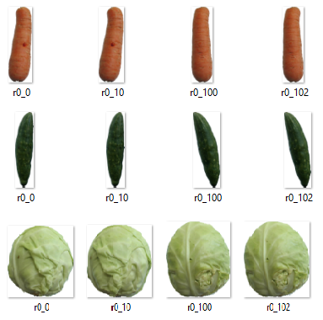
DATASET
A collection of data pieces that can be treated by a computer as a single unit for analytic and prediction purposes
Dataset used for experiment is Fruits360 from Kaggle.

Slide 8
APPROACH
Case 1 : By changing various HTM Parameter to find the best fit correlation Matrix
Change various learning parameters and to find the best fit that shows image classification.
Most important learning parameters are: Global/Local Inhibition, Potential Radius, Local Area Density and NumofActiveColumnsPerInArea and we found how these parameters influenced learning.
Case 2 : Modify the prediction code to calculate the highest similarity of the input images
To test the quality of learning we have developed the prediction code to calculate the highest similarity of the input images.

Slide 9
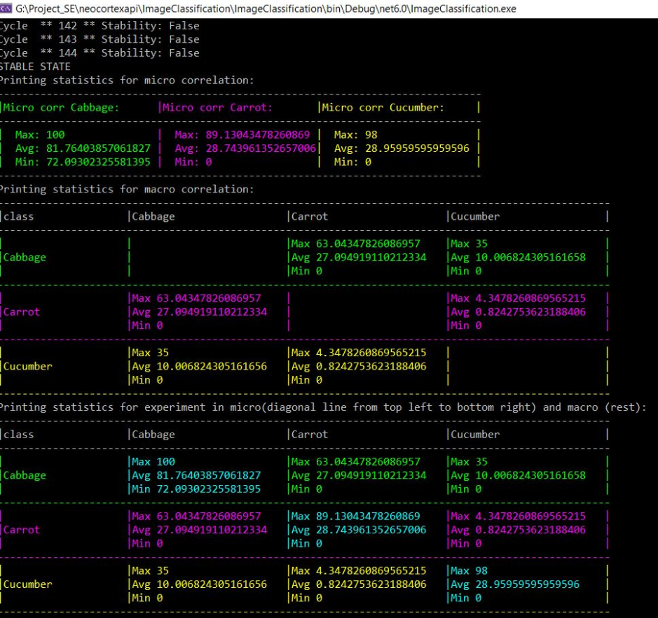
Case 1: SIMILARITY MATRIX

Slide 10
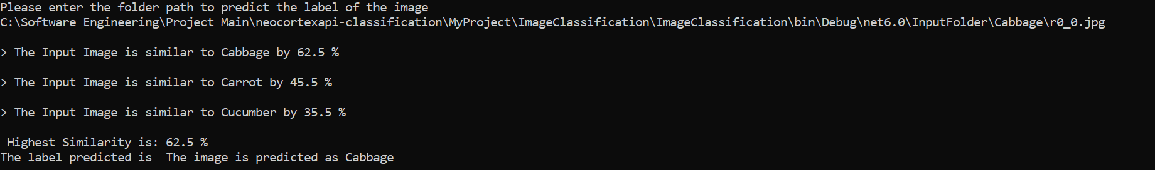
Case 2 : PREDICTION

Slide 11
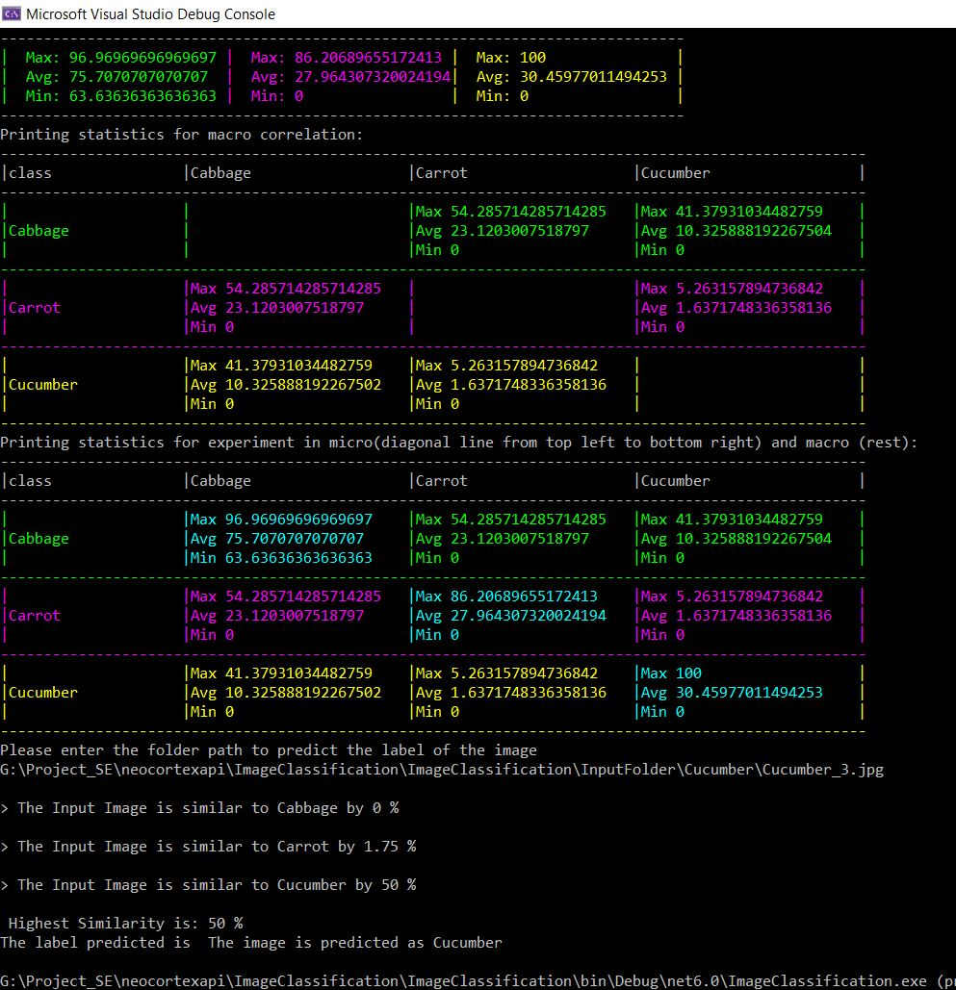
FINAL OUTPUT

Slide 12

CONCLUSION
Now in this era, there are many smart machines that use image recognition for the identification process. We can apply it to various real-life scenarios like medical field, robot vision, video processing etc.
The advancements of how our brains work biologically may lead to new and revolutionary ways of achieving a true machine intelligence, the aim of the HTM theory.
The test shows how the HTM parameters influence the learning and to get the best fit correlation matrix.
In order to improve the quality of learning we have developed the prediction code to calculate the highest similarity of the input images.

Slide 13
REFERENCE
C. Neto, M. Brito, H. Peixoto, V. Lopes, A. Abelha and J. Machado, "Prediction of Length of Stay for Stroke Patients Using Artificial Neural Networks," Information Systems and Technologies, vol. 1159, pp. 212-221, 2020.
A. Ghazanfar and C. Schroeder, "Is neocortex essentially multisensory?," Trends in Cognitive Sciences, vol. 10, no. 6, pp. 278-285, 2006.
S. Purdy, "Encoding Data for HTM Systems," Neural and Evolutionary Computing, no. arXiv:1602.05925, 2016.
Y. Cui, S. Ahmad and J. Hawkins, "Continuous Online Sequence Learning with an Unsupervised Neural Network Model," Neural Computation, vol. 28, no. 11, p. 2474–2504, 2016.
D. Maltoni, "Pattern Recognition by Hierarchical Temporal Memory," SSRN, 2011. [Online]. Available: https://papers.ssrn.com/sol3/papers.cfm?abstract_id=3076121. [Accessed March 2022].
D. Dobric, "Neocortexapi," [Online]. Available: https://ddobric.github.io/neocortexapi/.
M. Wirth, "Craftofcoding," WordPress, 17 2 2017. [Online]. Available: https://craftofcoding.wordpress.com/2017/02/13/image-binarization-1-introduction/. [Accessed 3 2022].

